Slide 1
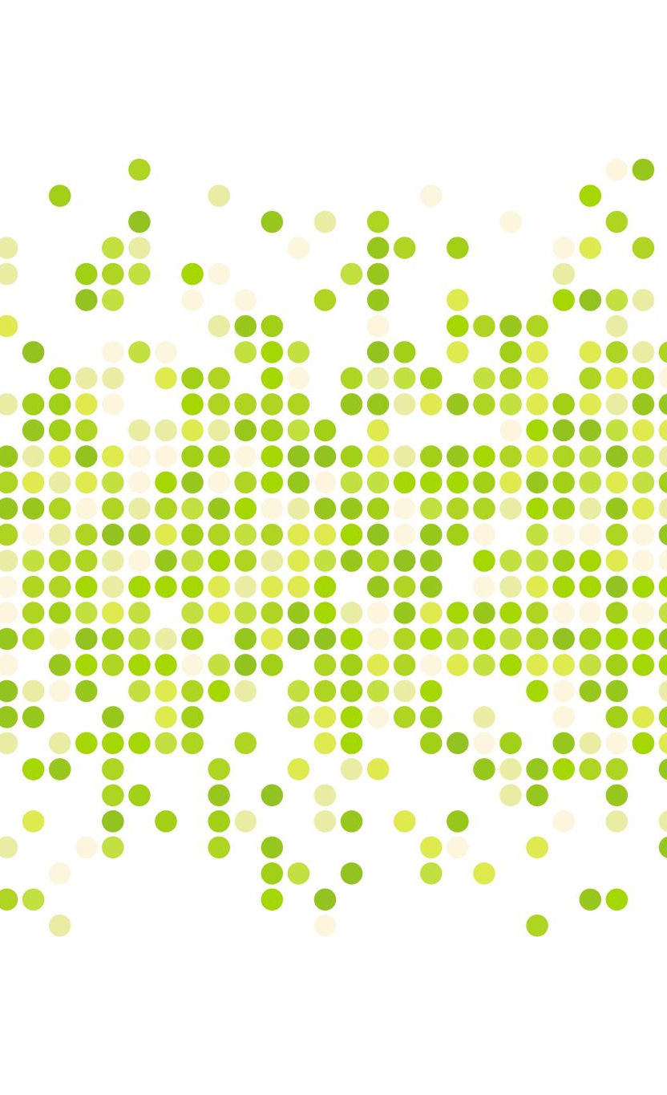
Cirrhosis Patient Survival Prediction
Apoorva Reddy Bagepalli
Shikha Kumari
Pratiksha Dange

Slide 2
Introduction
Liver cirrhosis is a severe liver condition resulting from prolonged damage, often caused by factors like hepatitis or chronic alcohol consumption. It leads to extensive scarring and impaired liver function, affecting millions of people worldwide. Predicting the survival of patients with liver cirrhosis is crucial for making informed medical decisions and improving patient.
Our project aims to utilize a dataset containing 17 clinical features to predict the survival state of patients with liver cirrhosis. The dataset includes information on patients' demographic characteristics, biochemical parameters, and treatment details. The survival states are categorized as follows: 0 = C (censored), 1 = CL (censored due to liver transplantation), 2 = D (death).
The motivation behind this project stems from the critical need to enhance patient care and treatment strategies for liver cirrhosis. By leveraging machine learning techniques and predictive modeling, we seek to develop a model that can accurately predict the survival outcomes of cirrhosis patients. This model could assist healthcare professionals in identifying high-risk patients, optimizing treatment plans, and ultimately improving patient survival rates and quality of life.

Slide 3
Data Preprocessing
Before diving into the analysis we have to perform some pre-processing techniques to make sure that the data is set for training.
Working on Identifiers
Encoding the data
Feature engineering
Oversampling the whole data

Slide 4
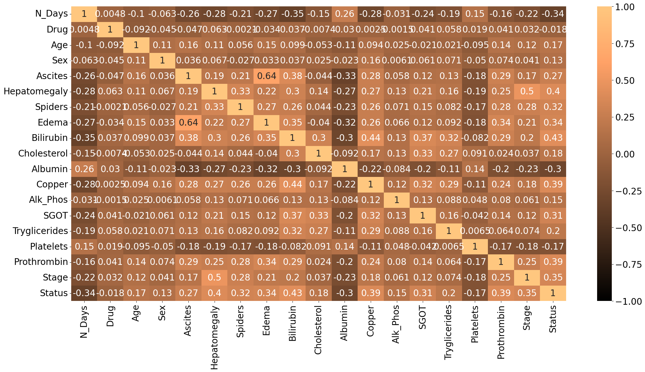
Exploratory Data Analysis

Slide 5
Stage and Hepatomegaly: A strong positive correlation (0.5) indicates that more advanced stages of cirrhosis are often accompanied by hepatomegaly, or an enlarged liver.
Stage and Survival Status: A strong negative correlation (-1.0) suggests that patients in more advanced stages of cirrhosis have a lower likelihood of survival.
Albumin, Bilirubin, and Edema: There is a moderate negative correlation between albumin levels and both bilirubin (-0.3) and edema (-0.32). This implies that lower albumin levels are associated with higher bilirubin levels and more severe edema, indicating worsening liver function as cirrhosis progresses.

Slide 6
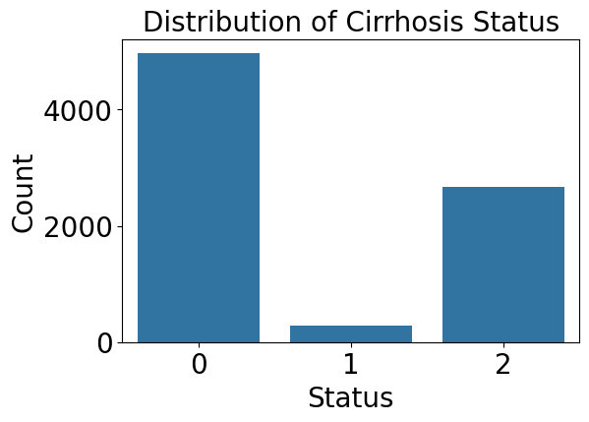
We can see most of the patients' status that is about 5000 were Censored, about 3000 patients were declared dead and not many patients were observed under status 'Censored due to liver transplantation'

Slide 7
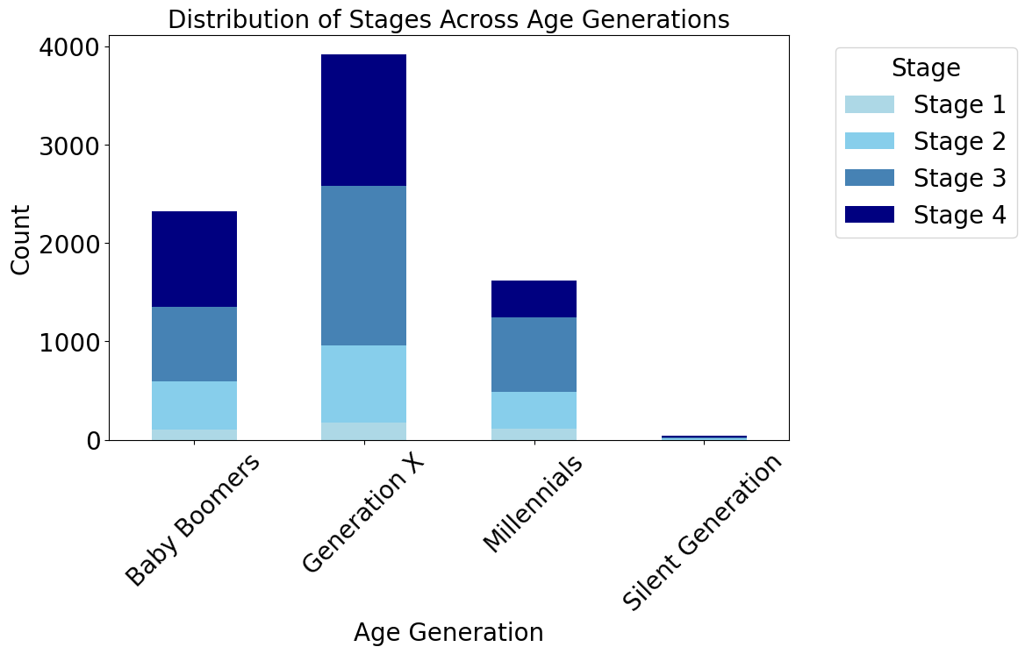

Slide 8
The chart indicates that cirrhosis progresses with age, with older generations such as Generation X showing more advanced stages.
Baby Boomers are most impacted, possibly due to their greater numbers or age.
The Silent Generation shows minimal representation, potentially due to smaller population sizes or lower incidence rates.
Meanwhile, Millennials are primarily in the initial stages, suggesting either early disease progression or differing generational impacts.

Slide 9
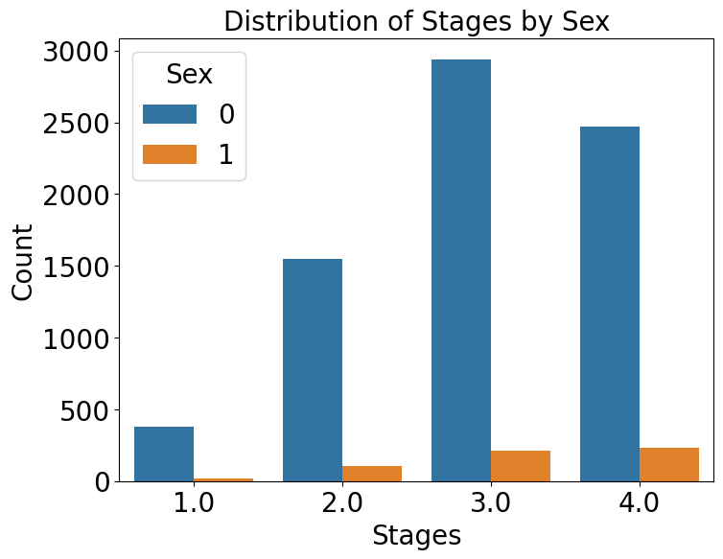
The chart shows more women (blue) than men (orange) across all stages, with the largest gender disparity in Stage 1.
Stage 3 is the most common for both sexes, followed by Stage 4 and Stage 2, with Stage 1 being the least common.
This suggests a higher prevalence or diagnosis rate of the condition among women.

Slide 10
Modelling
We performed 4 prominent Machine Learning models which are
Random Forest Classifier
Linear Discriminant Analysis
Extreme Gradient Boosting Classifier
Support Vector Classifier

Slide 11
Random Forest Classifier
For classification tasks, each tree in the forest independently predicts the class label, and the class with the most votes across all trees is assigned as the final prediction. For regression tasks, the average prediction of all trees is taken.
Random Forest employs a technique called bagging (Bootstrap Aggregating), which involves training each tree on a random sample of the training data with replacement. This further adds to the model's robustness and reduces variance.
Random Forest provides a measure of feature importance based on how much each feature reduces impurity across all the trees in the forest. This can be useful for feature selection and understanding the predictive power of different features.
Balanced Accuracy scores
0.605 (Without Oversampling)
0.938 (With Oversampling)

Slide 12
Linear Discriminant Analysis
The primary goal of LDA is to maximize the separation between classes while minimizing the variance within each class.
LDA achieves dimensionality reduction by projecting the data onto a lower-dimensional subspace while preserving the class discriminatory information as much as possible.
In classification tasks, LDA assigns a new data point to the class with the highest posterior probability based on the linear discriminant functions learned during training.
Balanced Accuracy scores
0.518 (Without Oversampling)
0.636 (With Oversampling)

Slide 13
Extreme Gradient Boosting Classifier
XGBoost builds an ensemble of decision trees sequentially. Each new tree is trained to correct the errors made by the existing ensemble.
XGBoost incorporates various regularization techniques such as L1 and L2 regularization (also known as "ridge" and "lasso" regularization) to penalize overly complex models and prevent overfitting.
Balanced Accuracy scores
0.623 (Without Oversampling)
0.935 (With Oversampling)

Slide 14
Support Vector Classifier
In cases where the data is not linearly separable, SVC can employ a kernel function to map the original feature space into a higher-dimensional space where linear separation is possible. Common kernel functions include linear, polynomial, radial basis function (RBF), and sigmoid kernels.
SVC is inherently a binary classifier, meaning it separates data into two classes. However, it can be extended to handle multi-class classification using techniques like one-vs-one or one-vs-rest.
In OvO strategy, a binary classifier is trained for each pair of classes in the dataset. During prediction, each classifier votes for one of the two classes, and the class that receives the most votes across all classifiers is assigned as the final prediction. OvO creates N(N-1)/2 classifiers for N classes.
In OvR strategy, a binary classifier is trained for each class against all other classes combined. During prediction, each classifier predicts whether a sample belongs to its assigned class or not. The class with the highest confidence score (decision function value) is assigned as the final prediction. OvR creates N classifiers for N classes.
Balanced Accuracy scores
0.809 (Without Oversampling)
0.893 (With Oversampling)

Slide 15
Conclusion
Based on the comprehensive analysis conducted in this report, we have gained valuable insights into predicting the survival outcomes of patients with liver cirrhosis.
Our data preprocessing efforts, including the removal of identifiers, dataset encoding, and feature engineering, ensured that the dataset was optimized for analysis. Additionally, exploratory data analysis (EDA) provided us with crucial insights into the distribution and relationships among variables, enhancing our understanding of the dataset's characteristics.
The training and testing of four distinct machine learning models - Random Forest Classifier (RFC), Linear Discriminant Analysis (LDA), XGBoost (XGB), and Support Vector Classifier (SVC) - yielded promising results.
We apply balanced accuracy scoring metric, given the dataset is imbalanced and to get precise accuracy for each class.
Each model demonstrated commendable accuracy, with RFC and XGB achieving particularly high accuracies of 93.8% and 93.5% respectively.
These findings underscore the potential of machine learning techniques in predicting patient survival in liver cirrhosis cases. Such models hold promise in assisting healthcare professionals in identifying high-risk patients, optimizing treatment strategies, and ultimately improving patient outcomes and quality of life.
In conclusion, our project contributes to the ongoing efforts aimed at enhancing patient care and treatment strategies for liver cirrhosis, emphasizing the importance of predictive modeling in advancing medical practice and improving patient outcomes.

